Slide 1
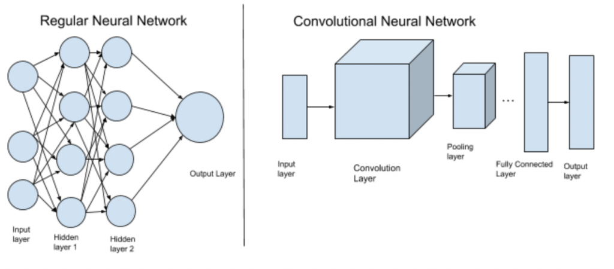
CNN INTRO

Slide 2
CONVOLUTION NEURAL NETWORK
Type of Deep Neural Network
Analyzing visual imagery (Detect cat, faces or objects)
Used in image & video recognition, natural language processing, recommender system, medical analysis
Currently used in self driving cars and robots
Future possibility: self-diagnoses of medical problems

Slide 3
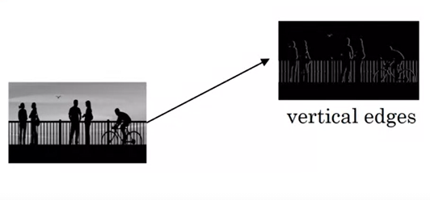
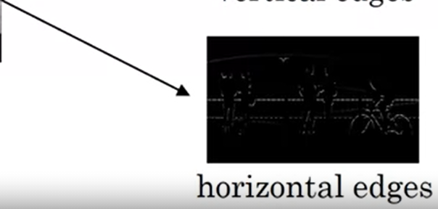
EDGE Detection

Slide 4
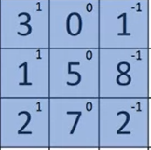
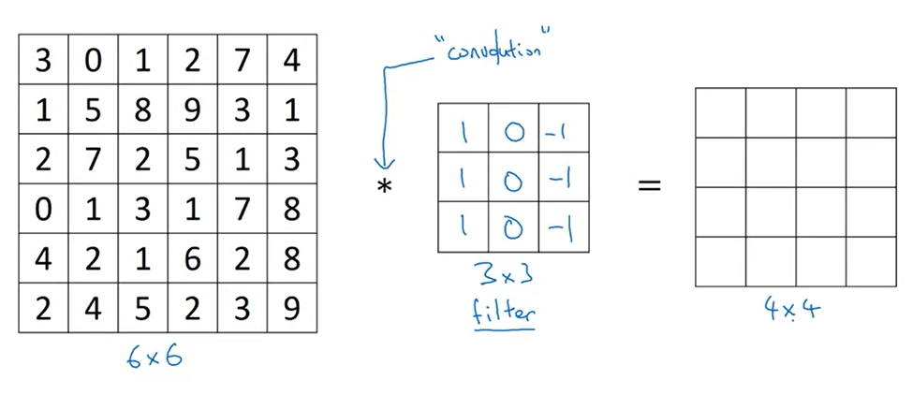
VERTICAL EDGE Detection
3x1 + 1x1 + 2x1 + 0x0 + 5x0 + 7x0 + 1x-1 + 8x-1 + 2x-1 = -5

Slide 5
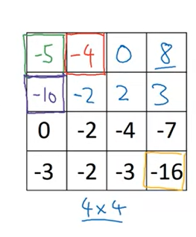
VERTICAL EDGE Detection
Python: conv-forward
Tensorflow: tf.nn.conv2d
Keras: conv2d

Slide 6
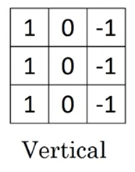
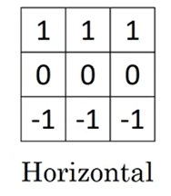
EDGE Detection Example
Vertical Edge
Horizontal Edge

Slide 7
PADDING
To overcome the convolution effects
Shrinking output
Throwing information on edges
Preserve the original input
Types: Valid & Same convolution
Valid has no padding
Same Convolution to keep the output size same as input

Slide 8

TYPE OF LAYERS IN CNN
Convolution
Pooling
Fully Connected layers

Slide 9
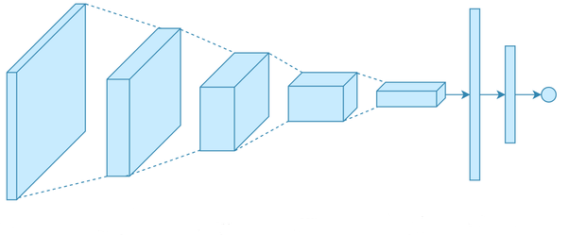
CNN

Slide 10
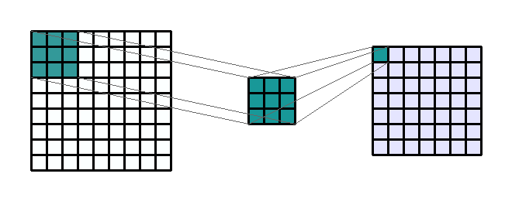
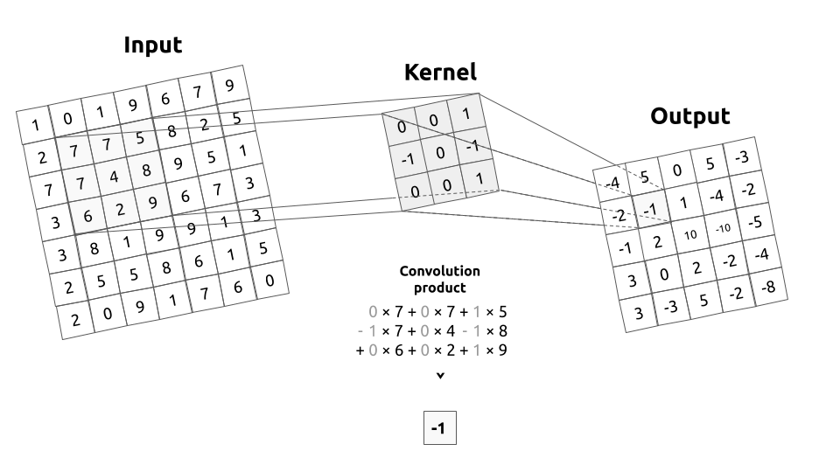
What is a Kernel
AKA convolution matrix
A kernel describes a filter that pass over an input image
the kernel will move over the whole image, from left to right, from top to bottom by applying a convolution product. The output of this operation is called a filtered image.
Input shape : (1, 9, 9)
Output Shape : (1, 7, 7)
— K : (3, 3) — P : (0, 0) — S : (1, 1) — D : (1, 1) — G : 1

Slide 11
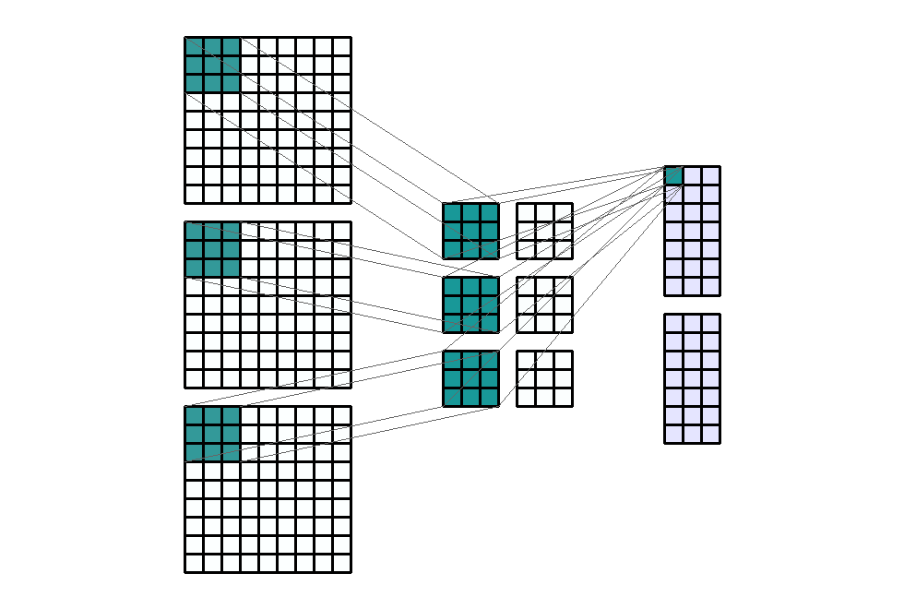
Strides
to downsample the output channel
strides of (1, 3)
Input Shape: (3, 9, 9)
— Output Shape : (2, 7, 3)
— K : (3, 3) — P : (0, 0) — S : (1, 3) — D : (1, 1) — G : 1

Slide 12
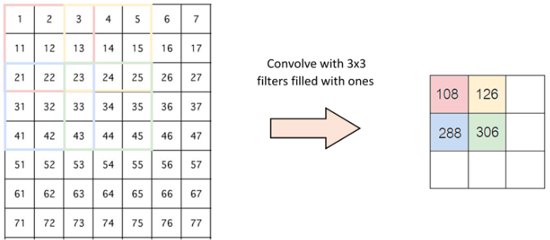
Strides 2
1
1
1
1
1
1
1
1
1

Slide 13
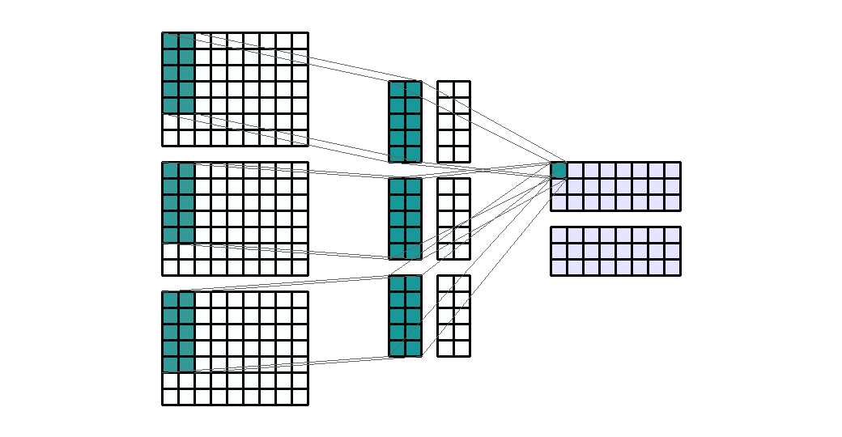
Input Shape: (3, 7, 9) Output Shape : (2, 3, 9) K : (5, 2) — P : (0, 0) — S : (1, 1) — D : (1, 1) — G : 1

Slide 14
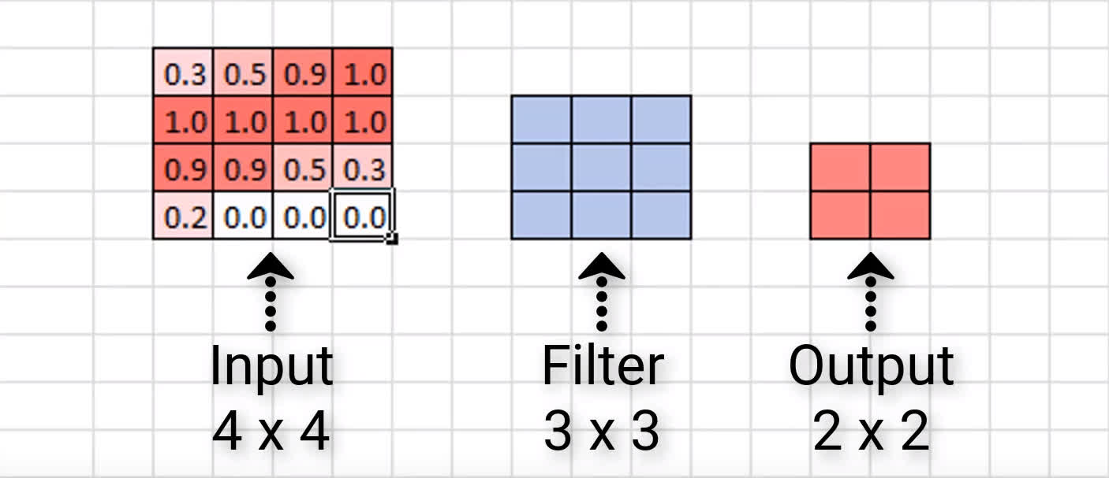
Convolutions Reduce Channel Dimensions
In general, if our image is of size n x n, and we convolve it with an f x f filter, then the size of the resulting output is x .
(n – f + 1)
(n – f + 1)

Slide 15
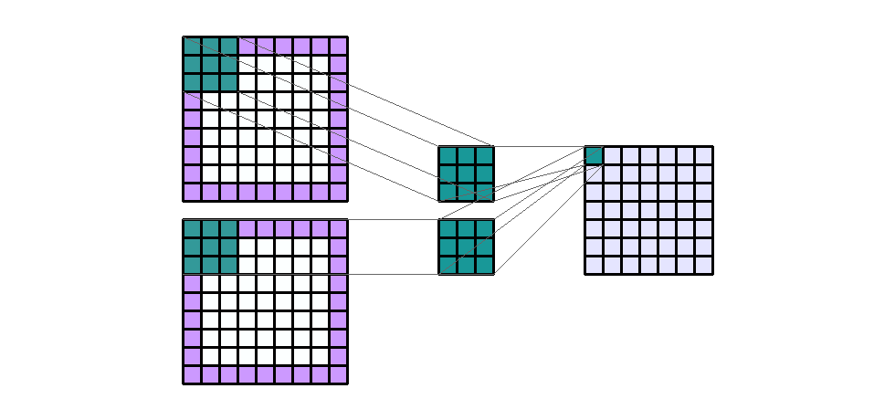
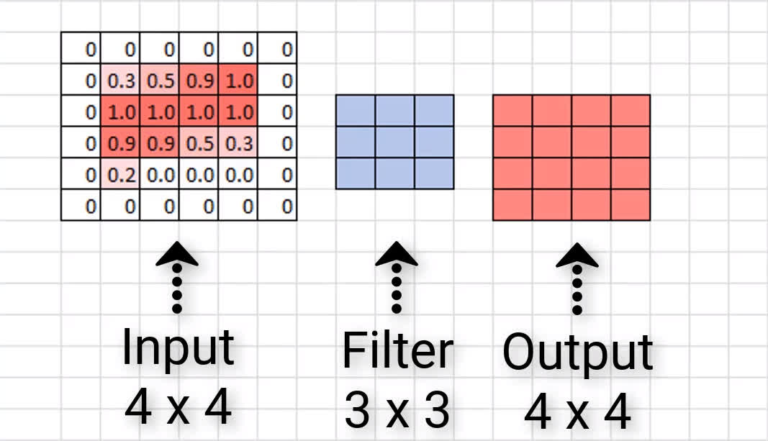
Padding
Zero Padding
Padding Type | Description | Impact
Valid | No padding | Dimensions reduce
Same | Zeros around the edges | Dimensions stay the same

Slide 16
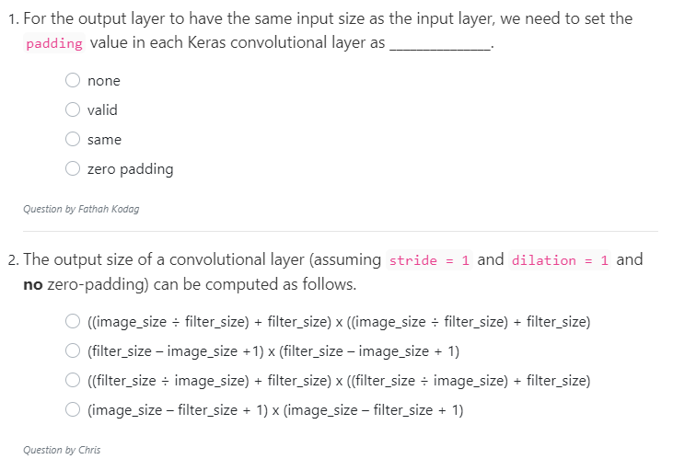
Quiz

Slide 17
Example VALID
model_valid = Sequential([
Dense(16, input_shape=(20,20,3), activation='relu'),
Conv2D(32, kernel_size=(3,3), activation='relu', padding='valid'),
Conv2D(64, kernel_size=(5,5), activation='relu', padding='valid'),
Conv2D(128, kernel_size=(7,7), activation='relu', padding='valid'),
Flatten(),
Dense(2, activation='softmax')
])
Layer (type) Output Shape Param #
=================================================================
dense_2 (Dense) (None, 20, 20, 16) 64
_________________________________________________________________
conv2d_1 (Conv2D) (None, 18, 18, 32) 4640
_________________________________________________________________
conv2d_2 (Conv2D) (None, 14, 14, 64) 51264
_________________________________________________________________
conv2d_3 (Conv2D) (None, 8, 8, 128) 401536
_________________________________________________________________
flatten_1 (Flatten) (None, 8192) 0
_________________________________________________________________
dense_3 (Dense) (None, 2) 16386
=================================================================
Total params: 473,890
Trainable params: 473,890
Non-trainable params: 0
_________________________________________________________________

Slide 18
Example SAME
model_same = Sequential([
Dense(16, input_shape=(20,20,3), activation='relu'),
Conv2D(32, kernel_size=(3,3), activation='relu', padding='same'),
Conv2D(64, kernel_size=(5,5), activation='relu', padding='same'),
Conv2D(128, kernel_size=(7,7), activation='relu', padding='same'),
Flatten(),
Dense(2, activation='softmax')
])
_________________________________________________________
Layer (type) Output Shape Param #
=================================================================
dense_6 (Dense) (None, 20, 20, 16) 64
_________________________________________________________________
conv2d_7 (Conv2D) (None, 20, 20, 32) 4640
_________________________________________________________________
conv2d_8 (Conv2D) (None, 20, 20, 64) 51264
_________________________________________________________________
conv2d_9 (Conv2D) (None, 20, 20, 128) 401536
_________________________________________________________________
flatten_3 (Flatten) (None, 51200) 0
_________________________________________________________________
dense_7 (Dense) (None, 2) 102402
=================================================================
Total params: 559,906
Trainable params: 559,906
Non-trainable params: 0
_________________________________________________________________

Slide 19
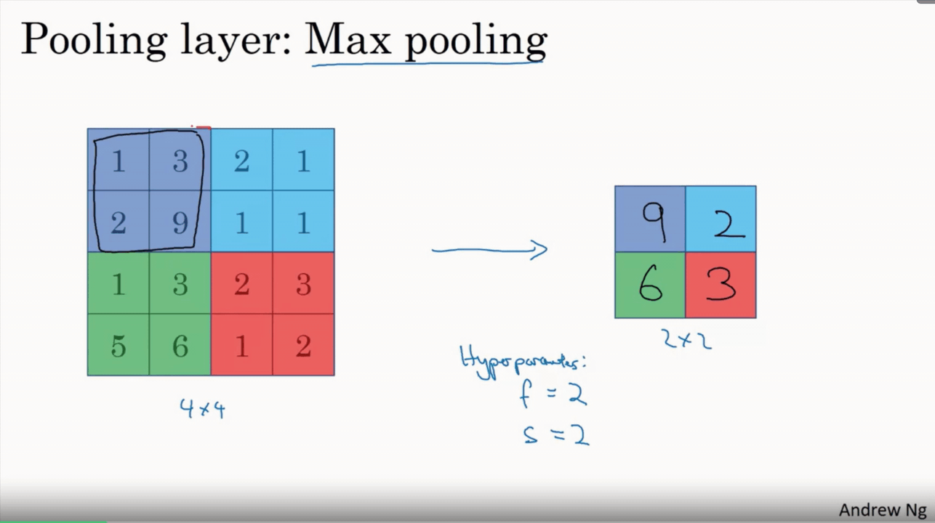
POLLING LAYERS
Downsampling operation
Reduce the size of the representation
To speed the computation
Applied after convolution layer

Slide 20
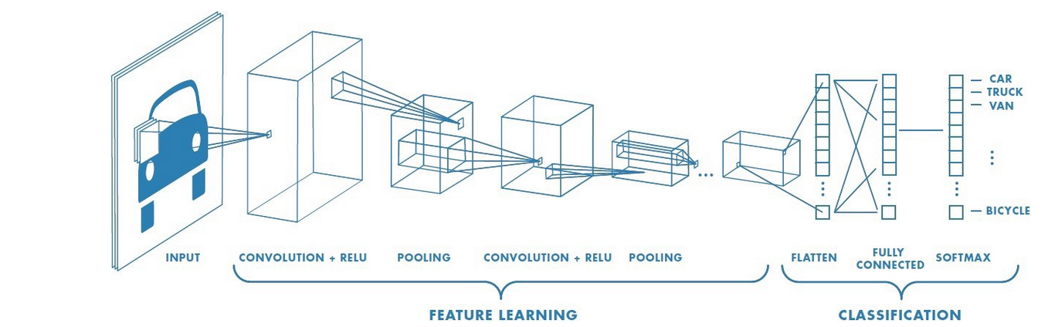
Convolution
Building block used in CNN
Application of a filter to an input that results in an activation

Slide 21
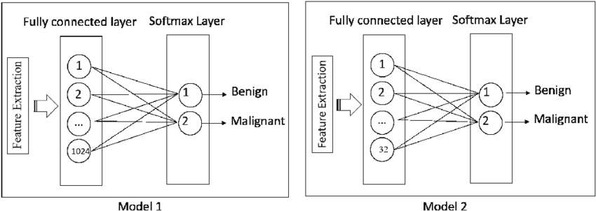
FULLY CONNECTED NEURAL NETWORK
Found towards the end of CNN architectures
To optimize the final result
Softmax gives the probability distribution of the label

Slide 22
MNIST
Modified National Institute of Standards and Technology dataset.

Slide 23
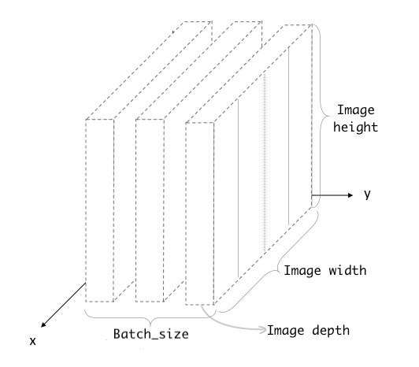
input data to CNN
Depth of the image, Image depth. It’s nothing but the number of colour channels. For example, an RGB image would have a depth of 3, and the greyscale image would have a depth of 1

Slide 24
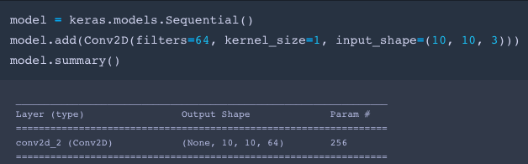
As you can notice the output shape is (None, 10, 10, 64). The first dimension represents the batch size, which is None at the moment. Because the network does not know the batch size in advance. Once you fit the data, None would be replaced by the batch size you give while fitting the data.

Slide 25
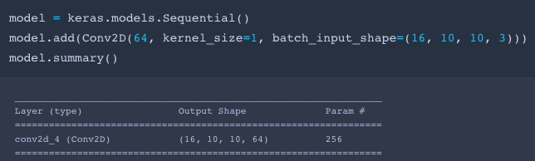
For example, you have to fit the data in the batch of 16 to the network only.
Now you can see that output shape also has a batch size of 16 instead of None.

Slide 26
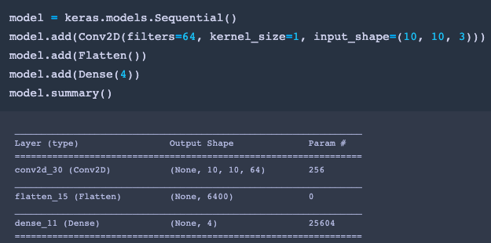
Attaching a Dense layer on Convolution layer
We usually add the Dense layers at the top of the Convolution layer to classify the images. However input data to the dense layer 2D array of shape (batch_size, units). And the output of the convolution layer is a 4D array. Thus we have to change the dimension of output received from the convolution layer to a 2D array.
We can do it by inserting a Flatten layer on top of the Convolution layer. Flatten layer squash the 3 dimensions of an image to a single dimension. Now we only have a 2D array of shape (batch_size, squashed_size), which is acceptable for dense layers.

Slide 27
THE END
https://deeplizard.com/learn/video/qSTv_m-KFk0

